Slide 1
Research Updates on GNN Species Discovery
Two Stage Training Protocol:
Stage I: Exploitation
Stage II: Exploration
Boyuan Yu, Rui Xu
University of Southern California
Sep. 18, 2026

Slide 2
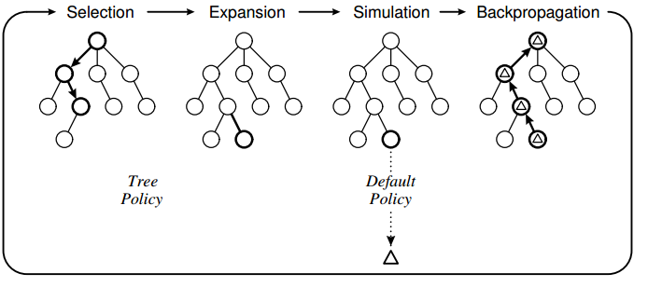
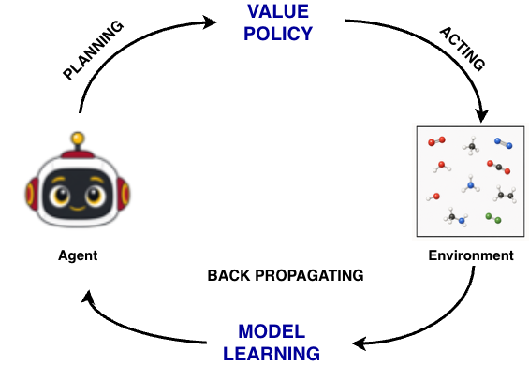

Previously Addressed Problems: Exploration Using Monte Carlo Tree Search
Previously: Implement Monte Carlo Tree Search (MCTS) for graph level evolution.
Monte Carlo Tree Search, together with PUCT (Polynomial Upper Confidence Bound applied to Trees), explore the graph evolution biased by the neural network (as a result of exploitation) and the number of exploration(s) of any individual state.
Bias in a nutshell:
  Neural Network bias: The higher value the state evaluated, the higher likelihood the state will be revisited during the exploration.
  Exploration bias: The more visiting a state received during an exploration batch, the less likely the state will be revisited in the same exploration batch.
Procedure wise, the neural network is retrained after each round of exploration with updated state values.

Slide 3
Objective: Train and Explore Species Given CH₄ Reaction Intermediates
Objectives:
Step I: Exploit the domain knowledge from a given species set.
Step II: Explore possible unknown species given the domain knowledge (acquired by neural network)
Test System Given Species:
H₂/O₂
  H₂, O₂, H, O, OH, H₂O, HO₂, H₂O₂
CO/CO₂
  CO, CO₂, HCO, CH₂O
C1
  CH₄, CH₃, CH₃O₂
  CH₂, CH, C
  CH₃O, CH₂OH, CH₃OH
C2
  C₂H₆, C₂H₅, C₂H₄, C₂H₃, C₂H₂, C₂H
  HCCO, CH₂CO, CH₂CHO, CH₃CHO, CH₃CO

Slide 4
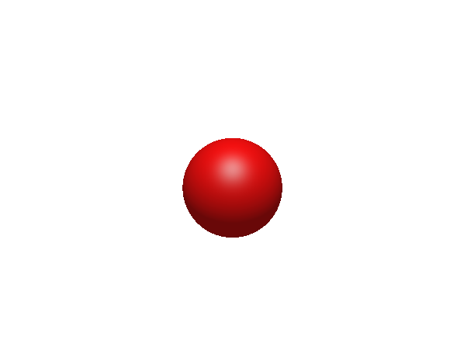
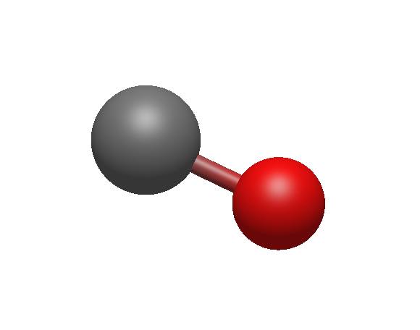
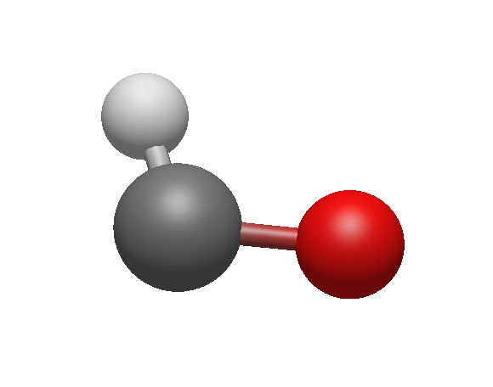
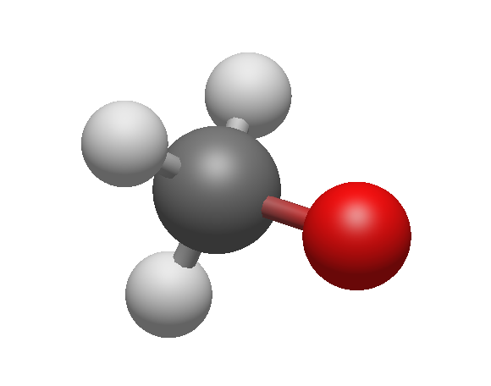
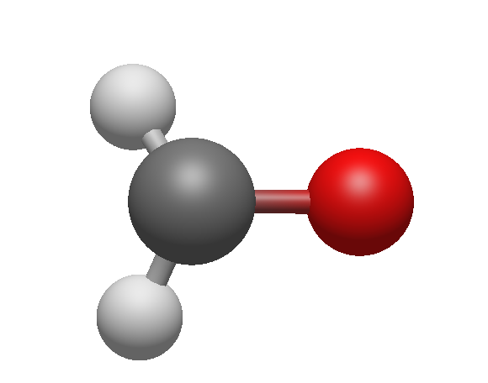
Stage I: Exploit Known Domain Knowledge
For a given species $s_{i}$, there are $N_{i}$ approaches to reach to final molecule.
For example, CH₃O has $\left({5 \atop 1,3,1}\right)=\frac{5!}{1!⋅3!⋅1!}=20$ construction approaches considering isomorphism (i.e. same type of atom are fundamentally the same with respect to the graph structure)
An example of forming CH₃O: Notice that ‘STOP’ is also a part of the procedure.
Incorporating ‘STOP’ helps the agent to naturally determine when the process will terminate instead of choosing fix number of construction steps.
Neural network will learn the policy from the decision of each step.
H
|
C—O
O
C — O
STOP
H
|
H— C—O
|
H
H
|
H— C—O

Slide 5
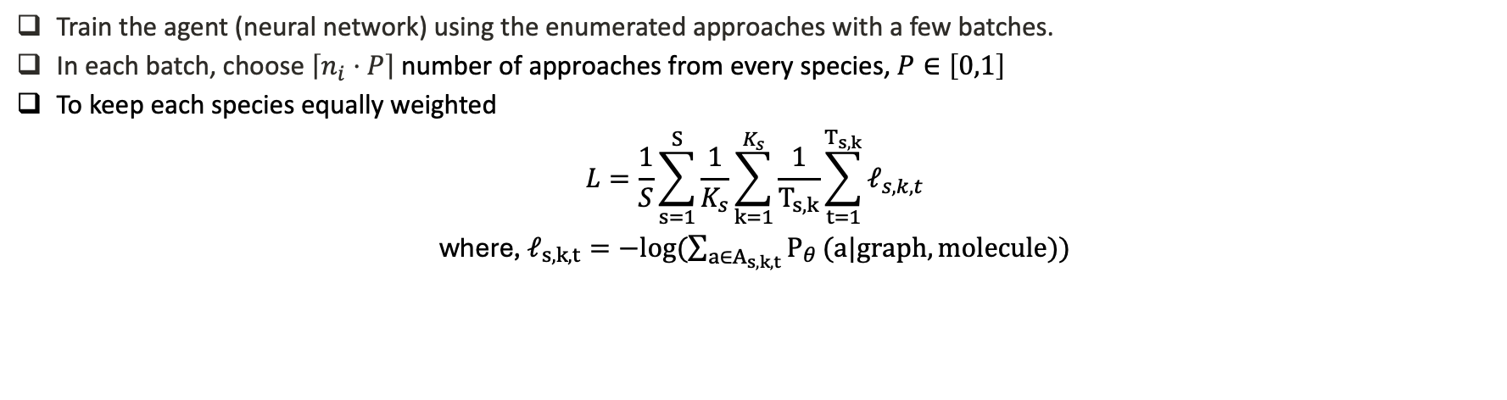
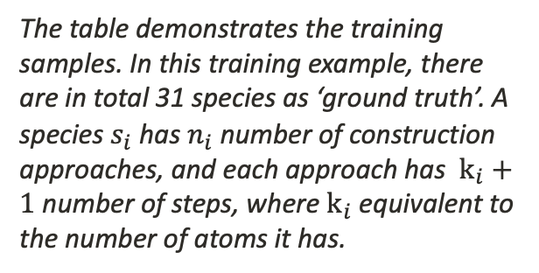
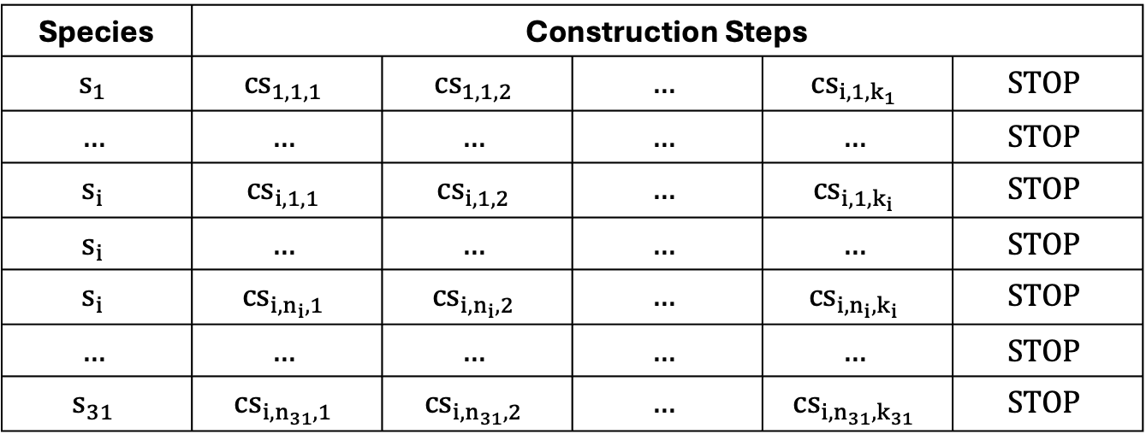
Stage I: Training Neural Network from Construction Approaches
Train the agent (neural network) using the enumerated approaches with a few batches.
In each batch, choose $\left\lceil n_{i}⋅P\right\rceil$ number of approaches from every species, $P∈\left[0,1\right]$
To keep each species equally weighted
$$L=\frac{1}{S}\sum_{s=1}^{S}{\frac{1}{K_{s}}}\sum_{k=1}^{K_{s}}{\frac{1}{T_{s,k}}}\sum_{t=1}^{T_{s,k}}{ℓ_{s,k,t}}$$
where, $ℓ_{s,k,t}=−log(\sum_{a∈A_{s,k,t}}{P_{θ}}(a|graph, molecule))$
Species | Construction Steps
$$s_{1}$$ | $${cs}_{1,1,1}$$ | $${cs}_{1,1,2}$$ | $$…$$ | $${cs}_{i,1,k_{1}}$$ | $$STOP$$
$$…$$ | $$…$$ | $$…$$ | $$…$$ | $$…$$ | $$STOP$$
$$s_{i}$$ | $${cs}_{i,1,1}$$ | $${cs}_{i,1,2}$$ | $$…$$ | $${cs}_{i,1,k_{i}}$$ | $$STOP$$
$$s_{i}$$ | $$…$$ | $$…$$ | $$…$$ | $$…$$ | $$STOP$$
$$s_{i}$$ | $${cs}_{i,n_{i},1}$$ | $${cs}_{i,n_{i},2}$$ | $$…$$ | $${cs}_{i,n_{i},k_{i}}$$ | $$STOP$$
$$…$$ | $$…$$ | $$…$$ | $$…$$ | $$…$$ | $$STOP$$
$$s_{31}$$ | $${cs}_{i,n_{31},1}$$ | $${cs}_{i,n_{31},2}$$ | $$…$$ | $${cs}_{i,n_{31},k_{31}}$$ | $$STOP$$
The table demonstrates the training samples. In this training example, there are in total 31 species as ‘ground truth’. A species $s_{i}$ has $n_{i}$ number of construction approaches, and each approach has $k_{i}+1$ number of steps, where $k_{i}$ equivalent to the number of atoms it has.

Slide 6
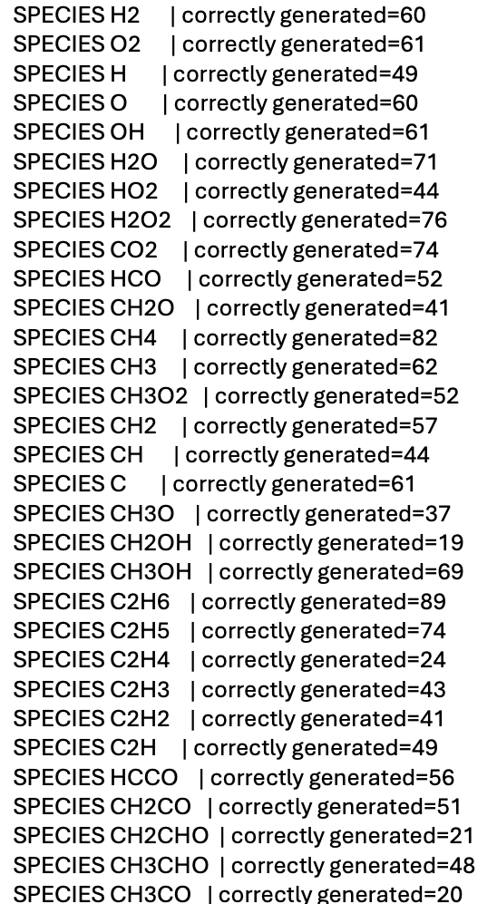
Stage I: Sanity Check
✅ All given species are successfully replicated
by agent’s forward propagation.

Slide 7
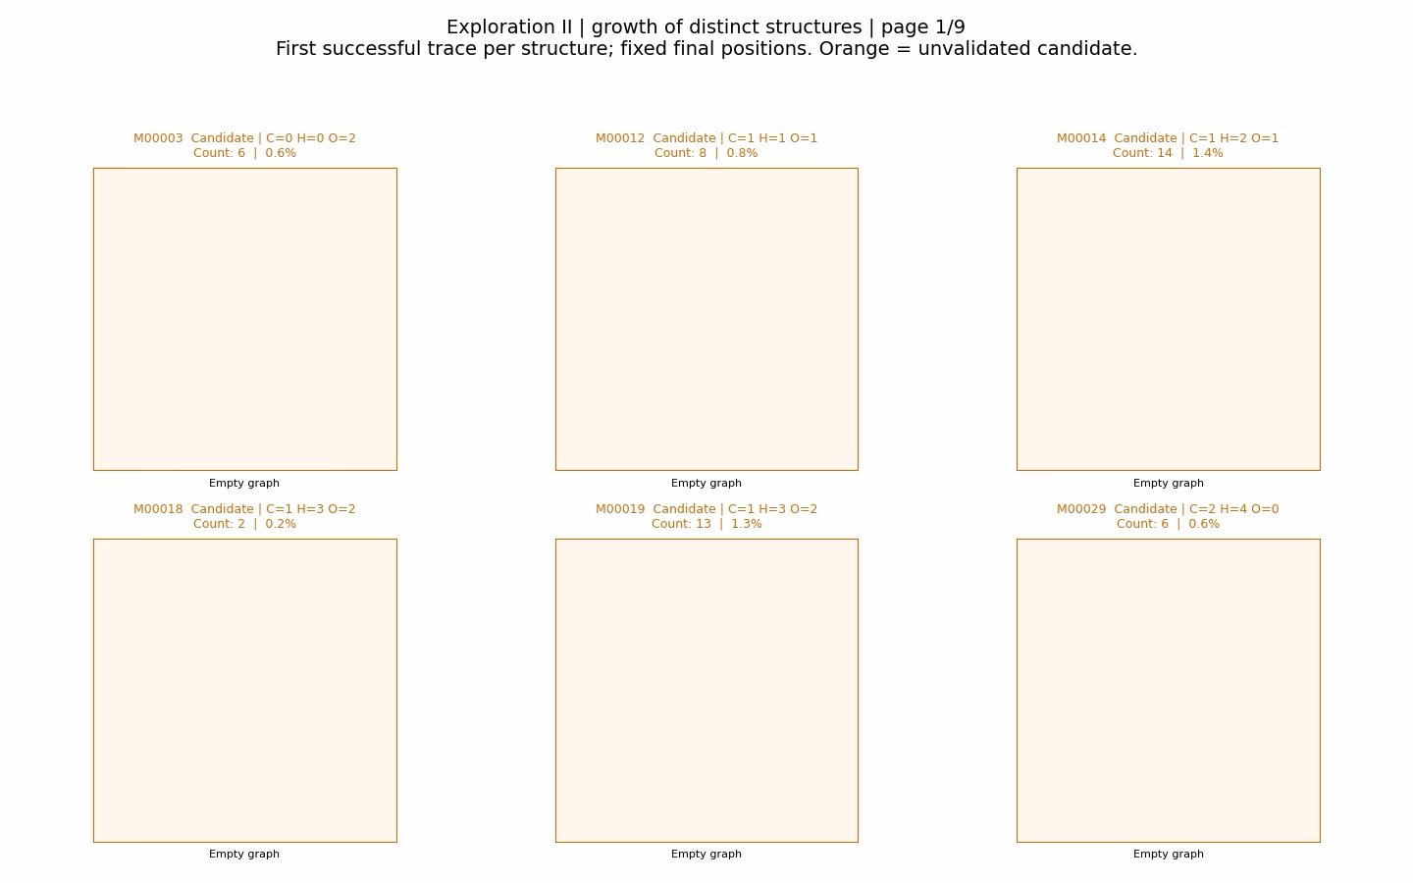
Stage II: Exploration with Given Agent

Slide 8
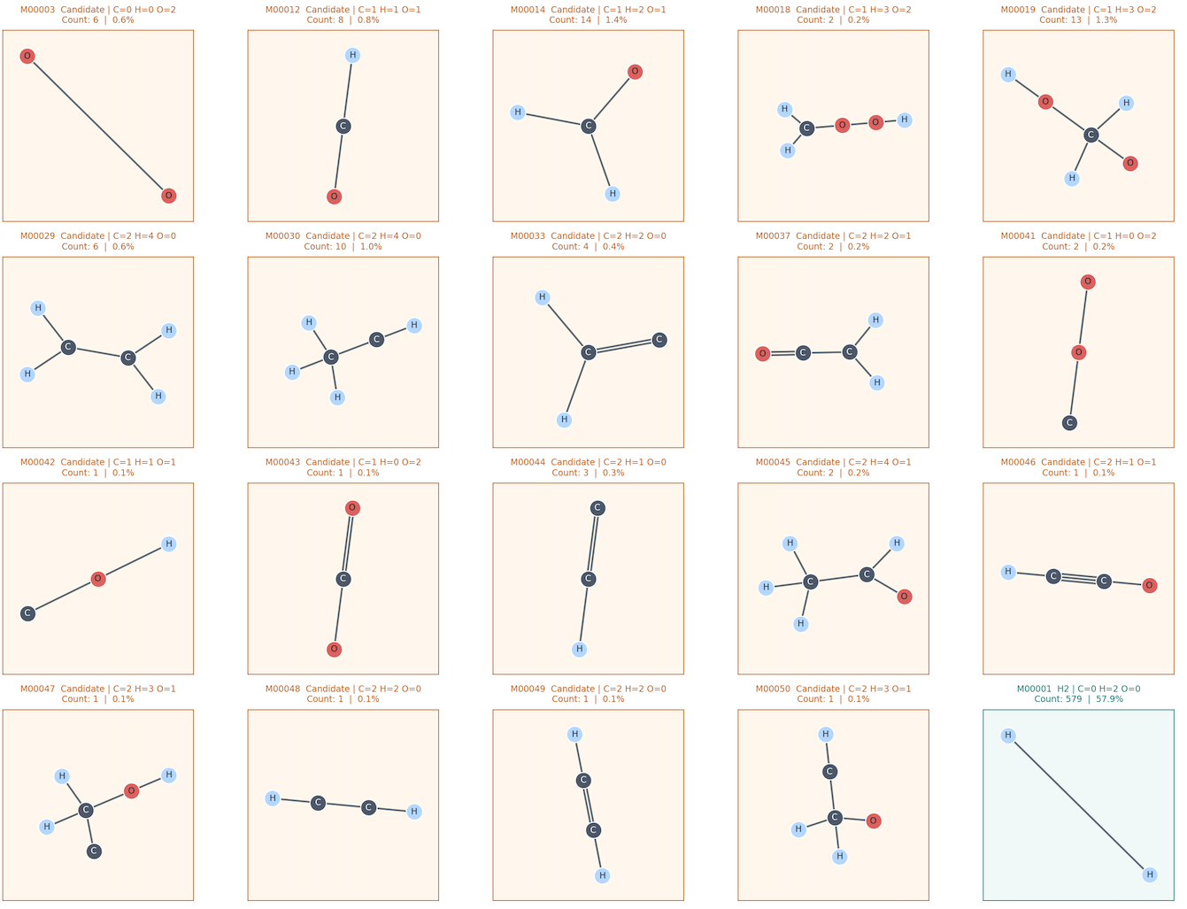
Stage II: Exploration Summary
Discovery of Unknown Species:
No long-chain hydroperoxyl is shown in the explored species list without external constraints.
No long-chain hydrocarbon is shown in the explored species list.
Aforementioned observations proof that with positive example only, the agent is capable to mimic the molecular structure of given species set, and stop at flexible yet reasonable step.

Slide 9
Achievement and Further Implementation
Achieved: The neural network agent is capable to acquire domain knowledge, replicate given molecules, and extend this knowledge in discover species.
Short come: the discover is only a small fraction of action during the exploration stage. The most repletely discovered unknown species presents only 1.4% among all explorations, whereas the least present known species presents ~30% among all explorations.
Potential solution: Implementing PUCT at the discovery stage, where the algorithm penalize frequent visited states and tends to explore unknown actions contributing to new species.
Toward New Horizons:
  Implement high fidelity, quantum mechanical tools to validate the explored species, which provide feedback to the agent. This process may help the algorithm to self-improve.

